Slide 1

British Airways: Model Building for Predictive analytics
Project Objectives: Predict booking of the customer
Data preparation: One hot encoding, data mapping, frequency encoding
Model Used: RandomForestClassifier
Performance Metrics: Accuracy, Precision, Recall, and F1 score
Feature importance: Key features

Slide 2
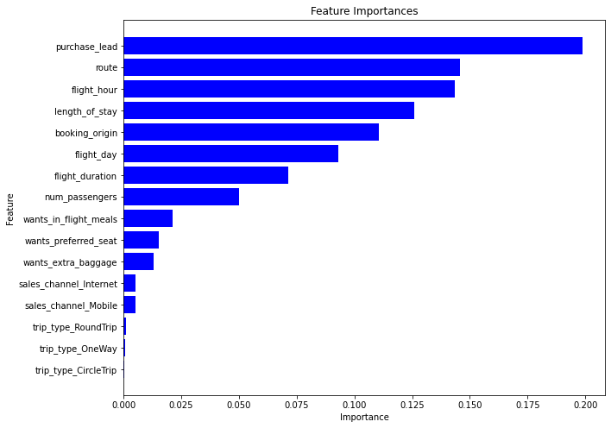
With top 8 features:
Average cross validation score: 0.6751
Accuracy: 0.8563
Precision: 0.82
Recall: 0.86
F1 Score: 0.81
Preprocessing steps:
trip type-- One hot encoding
sales_channel-- One hot encoding
flight day-- data mapping
route-- frequency encoding
booking origin-- frequency encoding

